Slide 1

What we’ll be doing during the interview

Slide 2
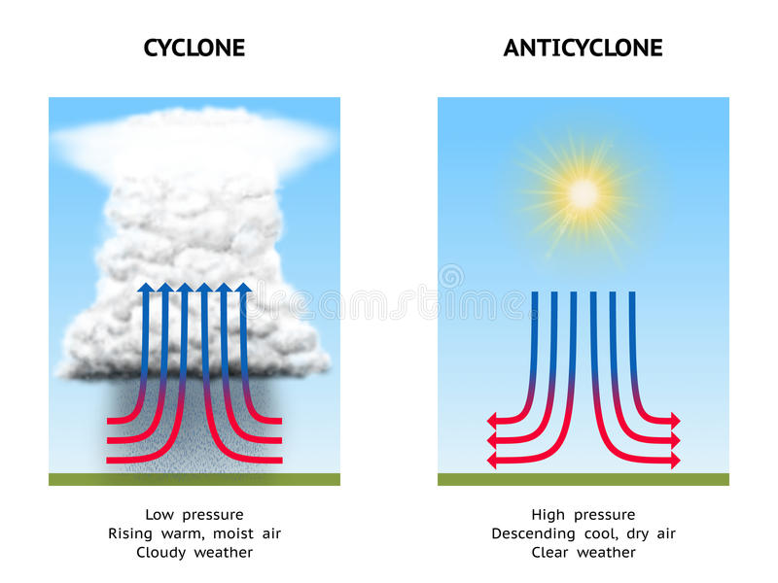
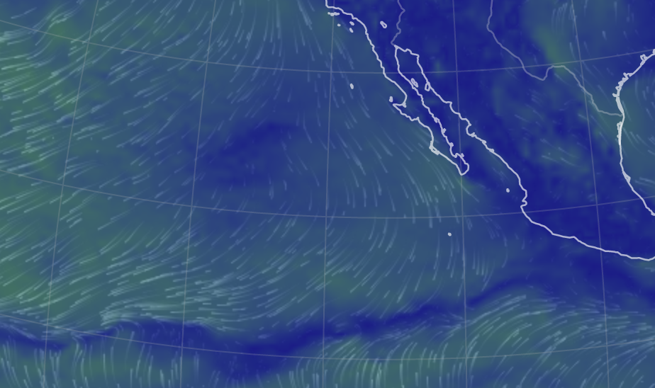
How to prepare: For our canned models, review them, and check out PPT slides about them
Earth.nullschool.net
Is it stormy and rainy here, or clear and dry?
Is this a low-pressure system or a high-pressure system?
Is it a cyclonic system or an anticyclonic system?

Slide 3

Review PPT slides that we worked through in class
Secondary:
Water vapor (H₂O)
Argon (Ar)
Trace amounts:
Carbon dioxide (CO₂)
Nitrous oxide (N₂O)
Methane (CH₄)
Ozone (O₃)

Slide 4
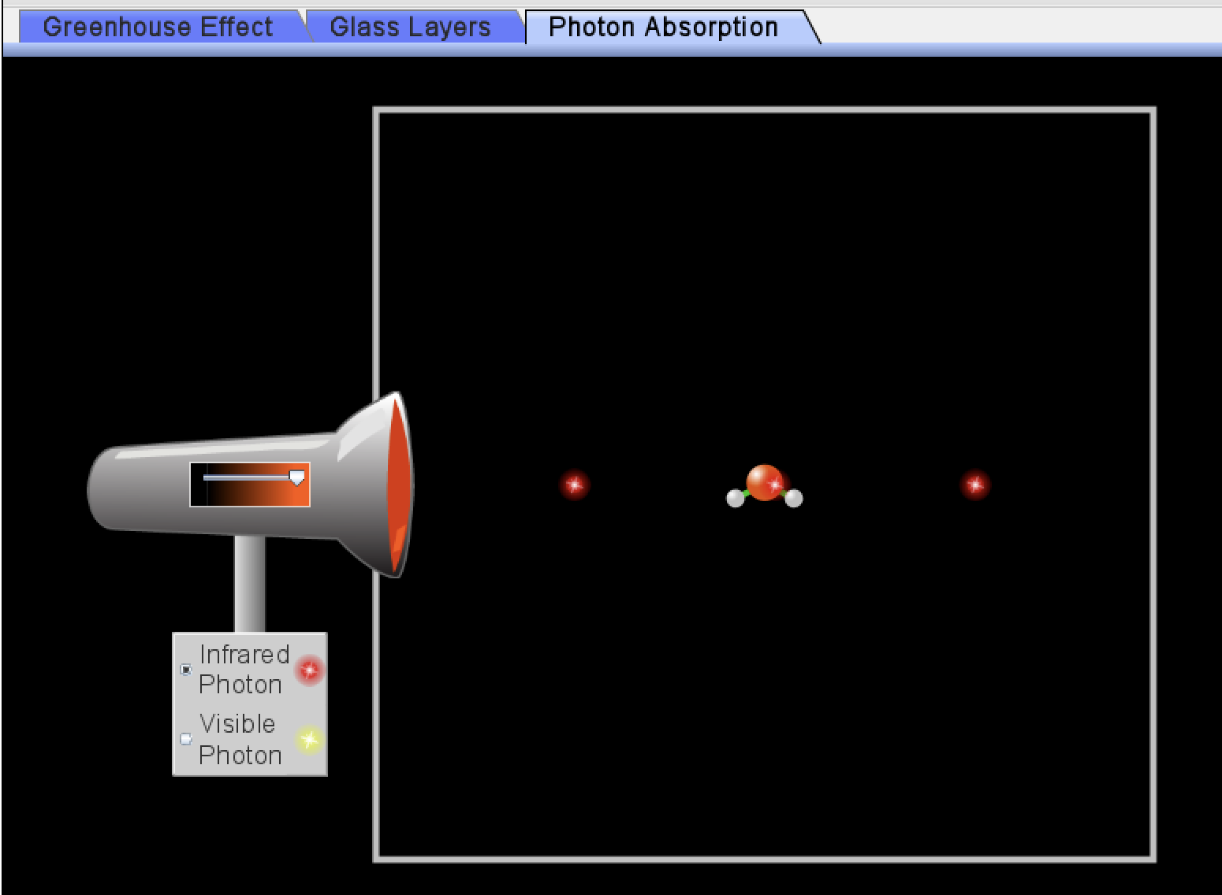
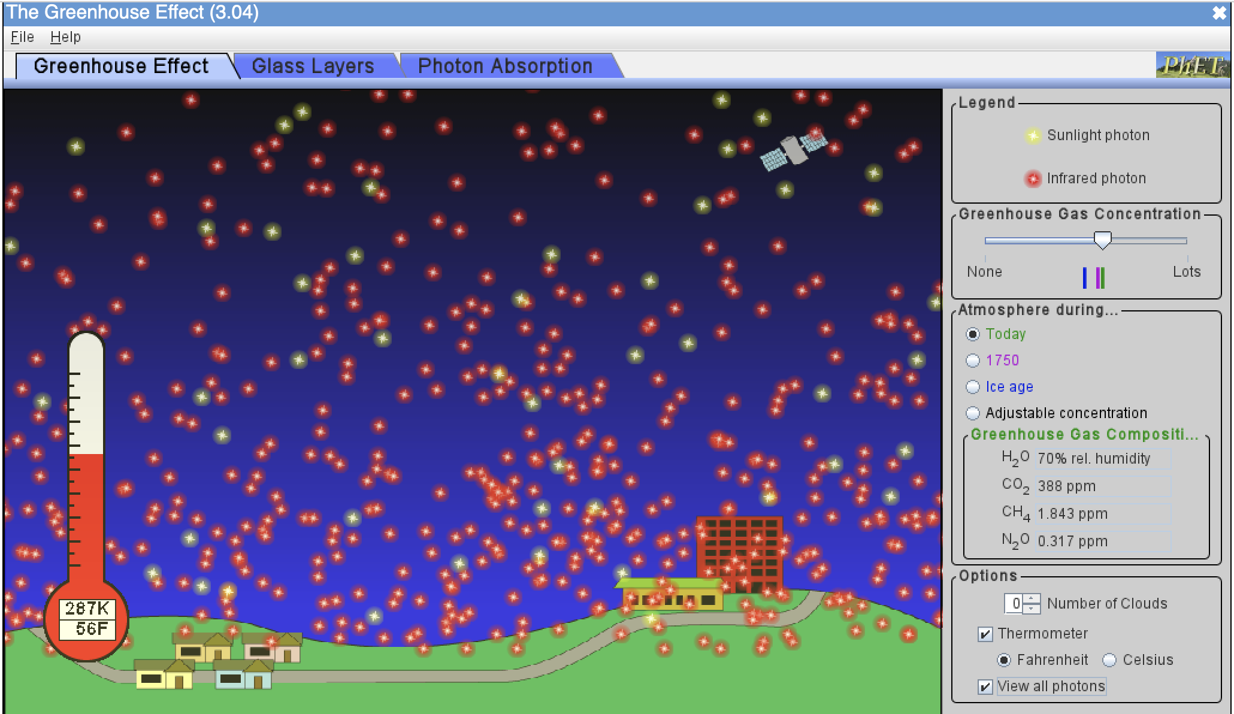
Review PPT slides that have questions on them
What kind of light (SW or LW) do GHG molecules absorb?
What happens to those molecules when they absorb that light?
Assuming radiative balance, why are there more LW photons leaving Earth than SW photons coming in?
What seems to be the homeostatic temperature (in degrees K, C, F) with default settings?
How much colder was it back in 1750 compared to now?
How much colder was it during ice ages compared to now?
What effect do clouds have on SW photons?
On LW photons?
On temperature?
https://phet.colorado.edu/sims/cheerpj/greenhouse/latest/greenhouse.html?simulation=greenhouse

Slide 5
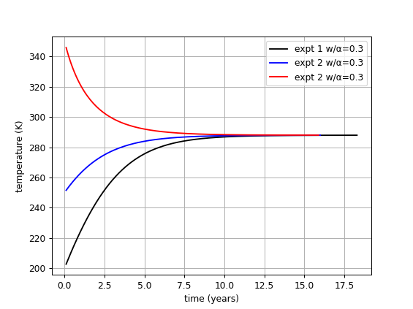
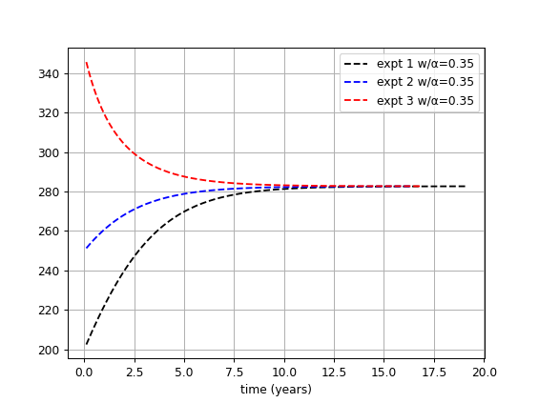
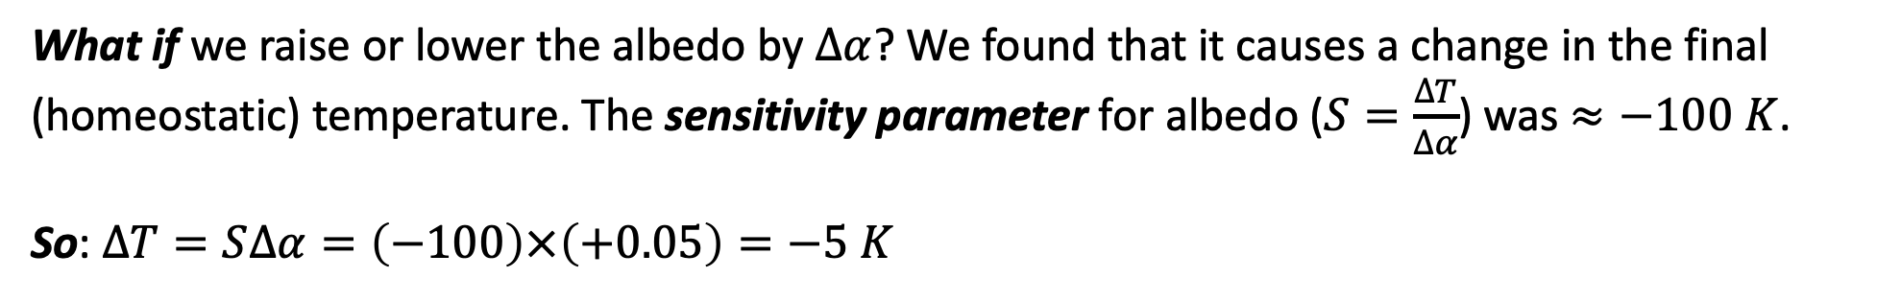
Often, what you did in Python has some take-home messages
What-if?
What if we raise or lower the albedo by $∆α$? We found that it causes a change in the final (homeostatic) temperature. The sensitivity parameter for albedo ($S=\frac{∆T}{∆α}$) was $≈−100 K$.
So: $∆T=S∆α=\left(−100\right)×\left(+0.05\right)=−5 K$

Slide 6
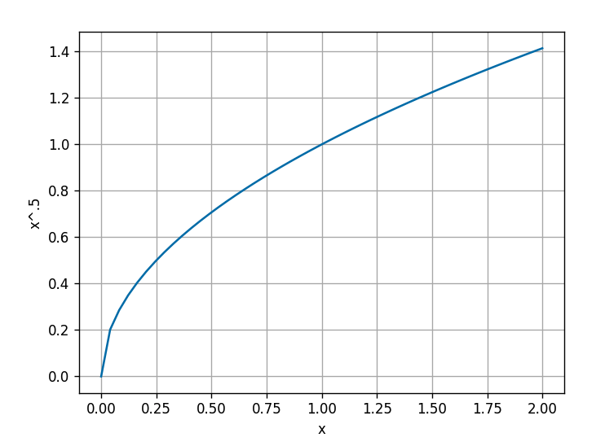
Don’t forget to pay attention to basic Python syntax (especially if you’ve done it a lot)
If we say this:
xarray = np.linspace(0,2,100)
rootx = xarray**(1/2)
Then, which of the following will produce the graph shown at right?
plt.plot(xarray,rootx)
or
plt.plot(rootx, xarray)

Slide 7
Don’t forget to pay attention to basic Python syntax (especially if you’ve done it a lot)
If we say this:
xarray = np.linspace(0,2,100)
rootx = xarray**(1/2)
Then, which of the following will produce the graph shown at right?
plt.plot(xarray,rootx)
or
plt.plot(rootx, xarray)

Slide 8
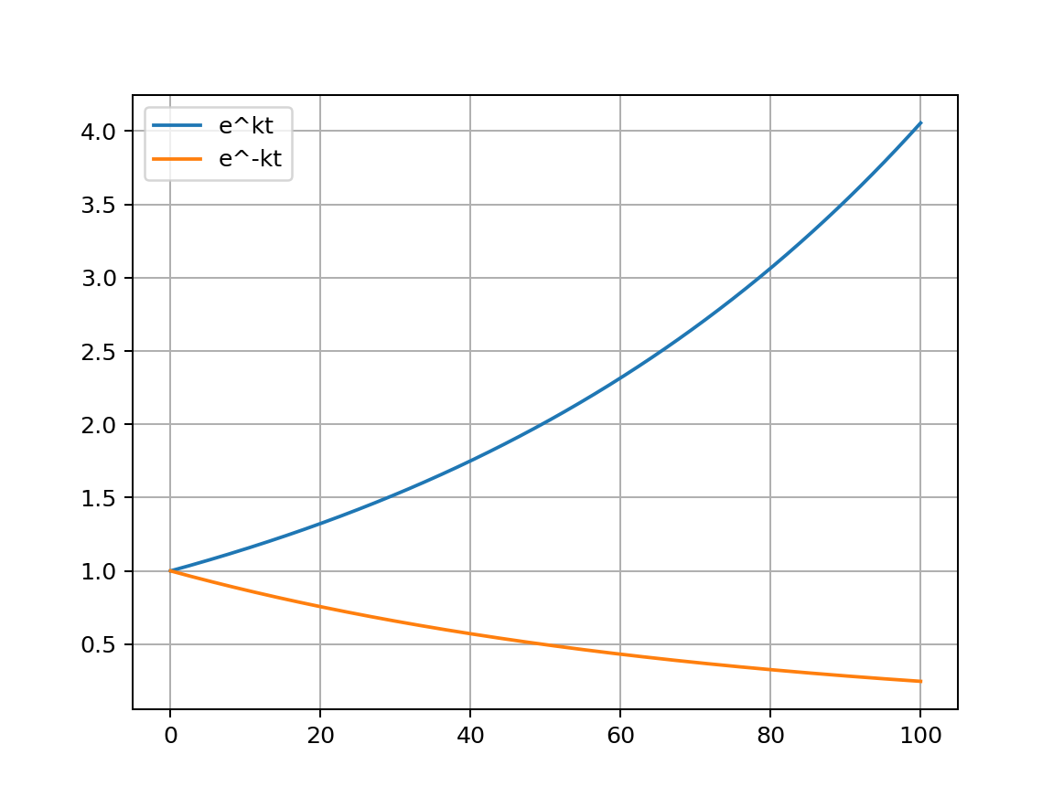
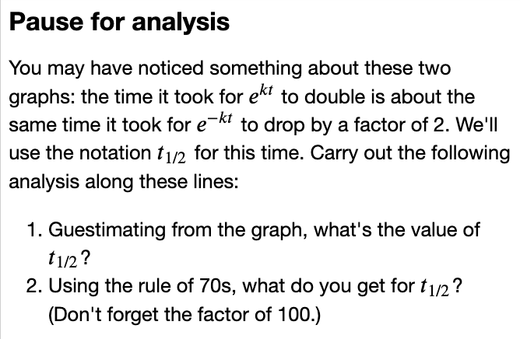
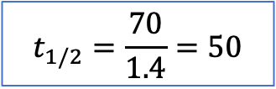

Also, take note of questions asked in Pause for Analysis
$$k = 0.014$$
$$t_{1/2}=\frac{70}{1.4}=50$$

Slide 9
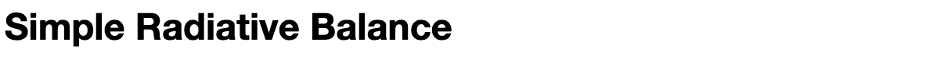
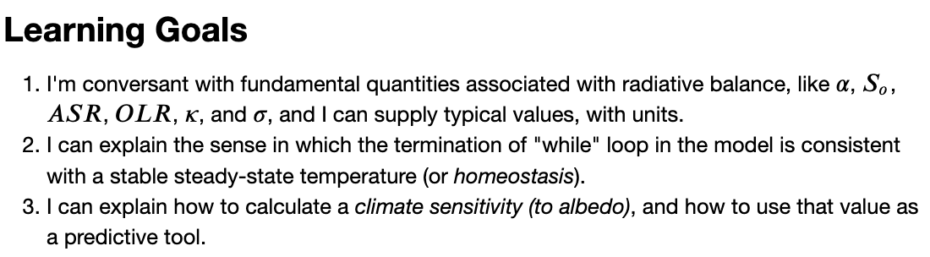
The CGIs generally have learning goals (often repeated in a PPT slide)

Slide 10
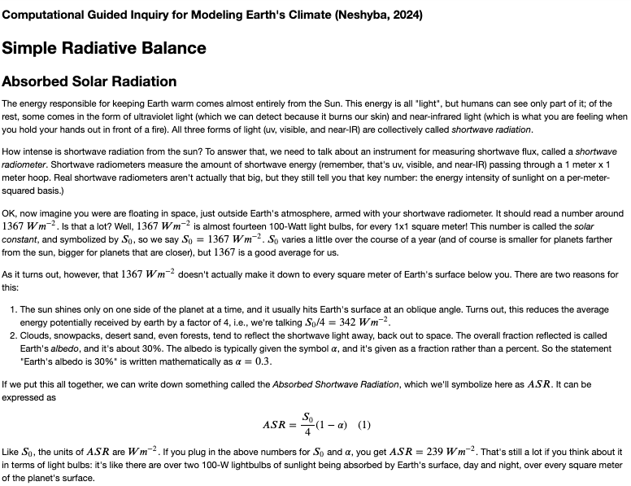
Introduction sections of our Python notebooks often provide important context (so read them)

Slide 11
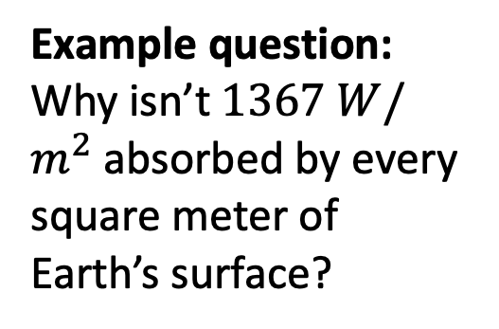
Introduction sections of our Python notebooks often provide important context (so read them)
Example question:
Why isn’t $1367 W/m^{2}$ absorbed by every square meter of Earth’s surface?

Slide 12
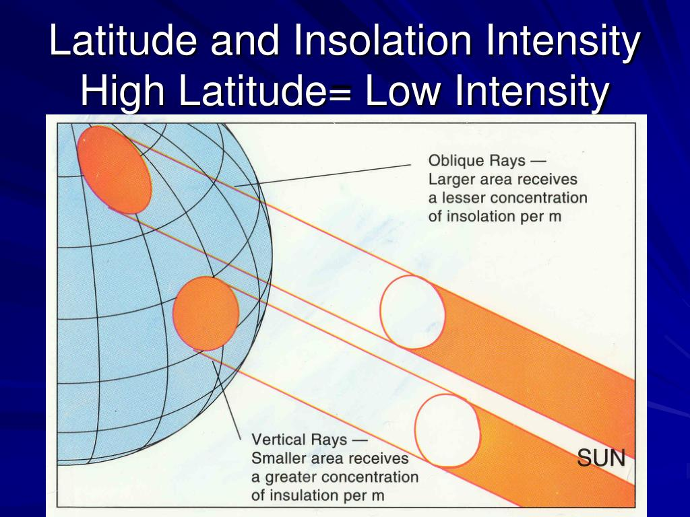
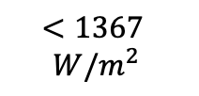
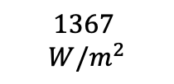
Introduction sections of our Python notebooks often provide important context (so read them)
Obliquity reason
Example question:
Why isn’t $1367 W/m^{2}$ absorbed by every square meter of Earth’s surface?
$$<1367$$
$W/m^{2}$
$$1367$$
$W/m^{2}$

Slide 13
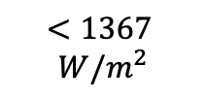
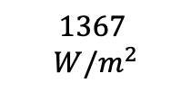
Introduction sections of our Python notebooks often provide important context (so read them)
Nighttime reason
only ½ of Earth gets sun at any given time
Example question:
Why isn’t $1367 W/m^{2}$ absorbed by every square meter of Earth’s surface?
$$<1367$$
$W/m^{2}$
$$1367$$
$W/m^{2}$

Slide 14

Introduction sections of our Python notebooks often provide important context (so read them)
Albedo reason
30% of sunlight is reflected
Example question:
Why isn’t $1367 W/m^{2}$ absorbed by every square meter of Earth’s surface?

Slide 15

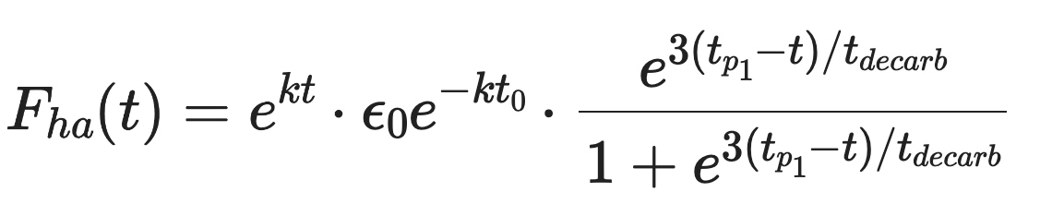
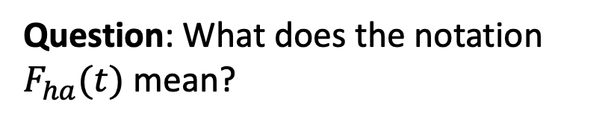
There are also some notational conventions that can be tricky (so ask if you’re uncertain)
Question: What does the notation $F_{ha}(t)$ mean?

Slide 16
There are also some notational conventions that can be tricky (so ask if you’re uncertain)
Question: What does the notation $F_{ha}(t)$ mean?

Slide 17
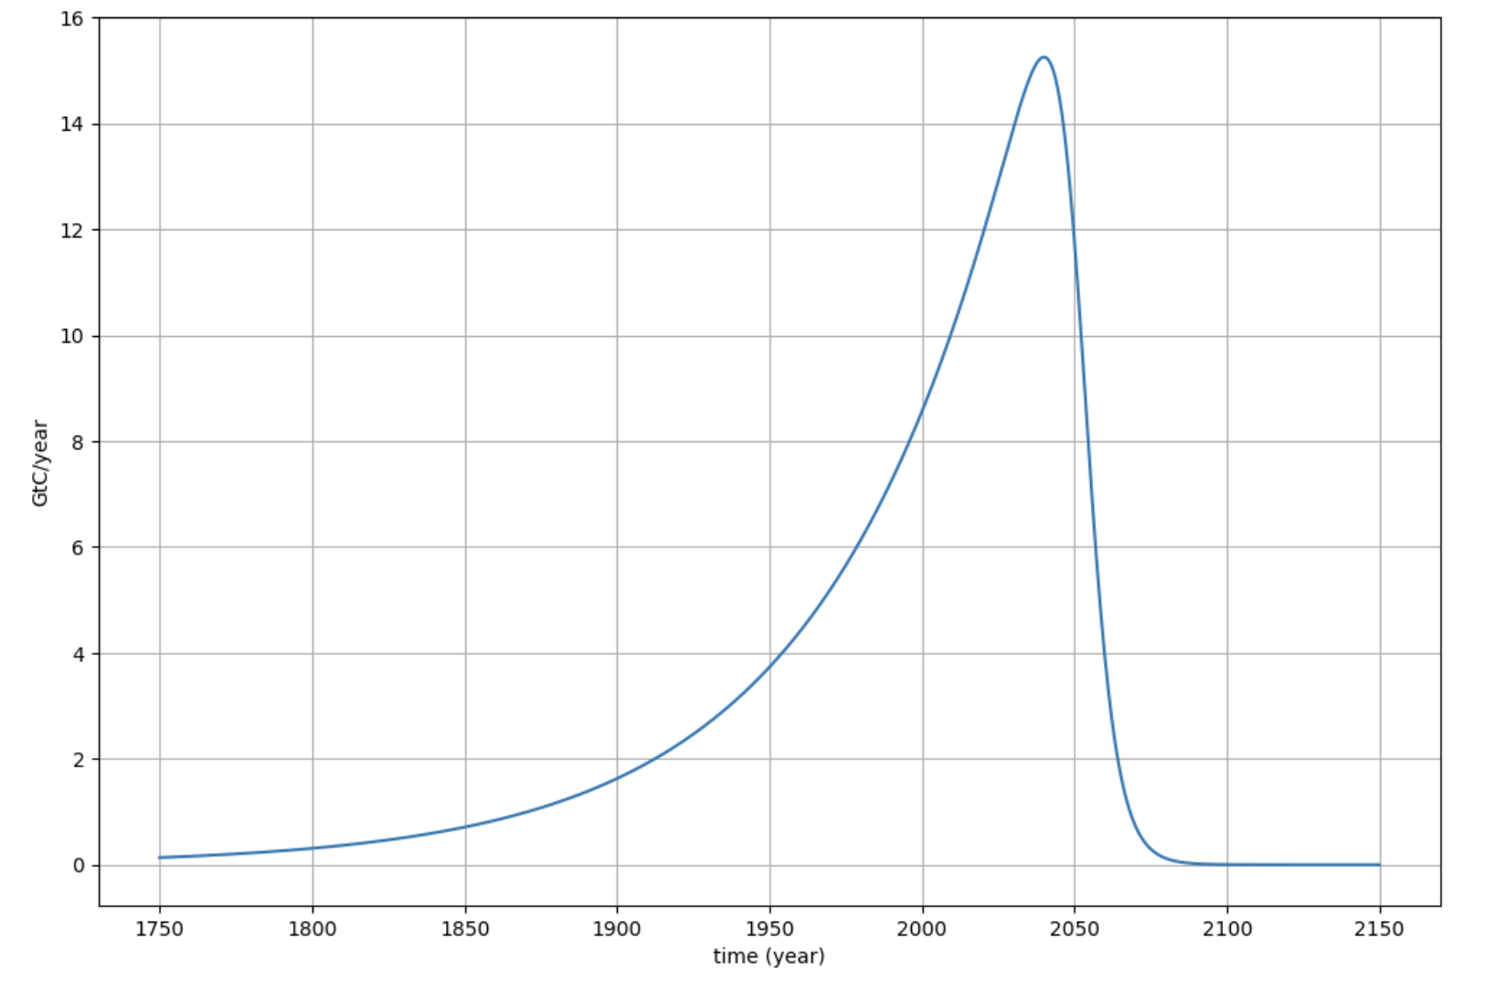
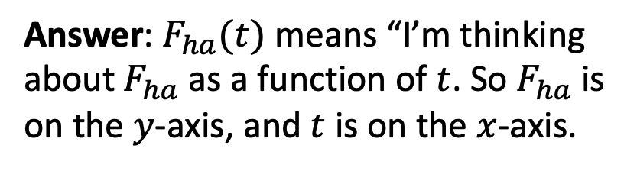
There are also some notational conventions that can be tricky (so ask if you’re uncertain)
Answer: $F_{ha}(t)$ means “I’m thinking about $F_{ha}$ as a function of $t$. So $F_{ha}$ is on the $y$-axis, and $t$ is on the $x$-axis.

Slide 18
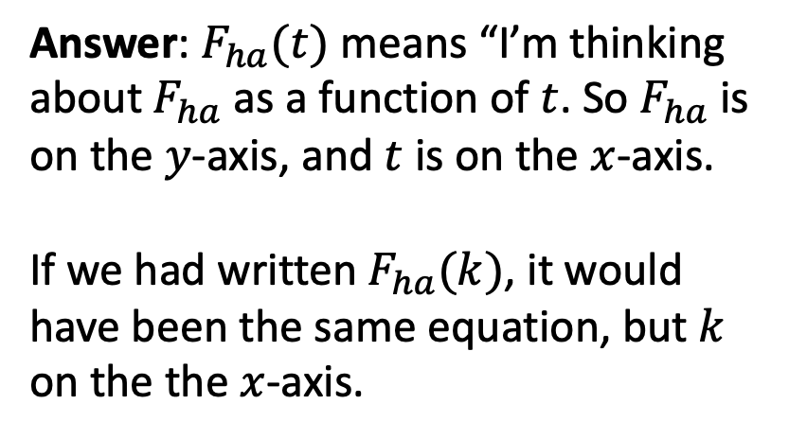
There are also some notational conventions that can be tricky (so ask if you’re uncertain)
Answer: $F_{ha}(t)$ means “I’m thinking about $F_{ha}$ as a function of $t$. So $F_{ha}$ is on the $y$-axis, and $t$ is on the $x$-axis.
If we had written $F_{ha}(k)$, it would have been the same equation, but $k$ on the the $x$-axis.

Slide 19
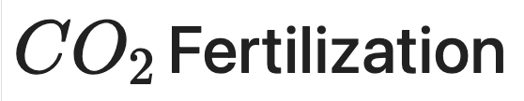
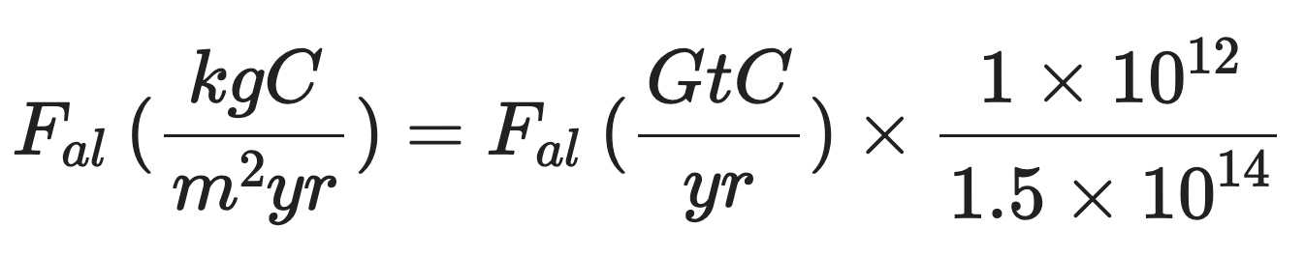
There are also some notational conventions that can be tricky (so ask if you’re uncertain)
Question: What does this notation mean?

Slide 20
There are also some notational conventions that can be tricky (so ask if you’re uncertain)
Answer: We wanted to indicate the units of the quantity.

Slide 21
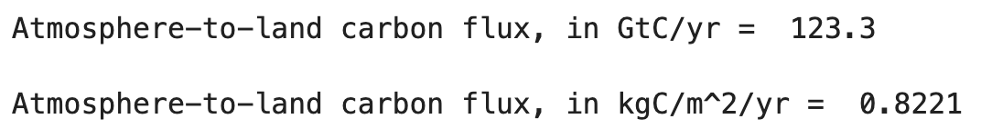
There are also some notational conventions that can be tricky (so ask if you’re uncertain)
Answer: We wanted to indicate the units of the quantity.

Slide 22
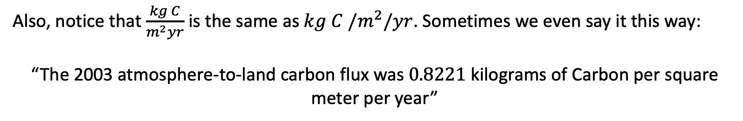
There are also some notational conventions that can be tricky (so ask if you’re uncertain)
Answer: We wanted to indicate the units of the quantity.
Also, notice that $\frac{kg C}{m^{2}yr}$ is the same as $kg C /m^{2}/yr$. Sometimes we even say it this way:
“The 2003 atmosphere-to-land carbon flux was $0.8221$ kilograms of Carbon per square meter per year”

